Slide 1

Managing Cash Flow
Updated: 09-2016

Slide 2

Pre-Test
In your Participant Guide
Locate the Pre- and Post-Test Form at the back of your Participant Guide.
Complete the BEFORE Training column to assess your knowledge on this topic before participating in this class.

Slide 3
Agenda
Welcome, Pre-Test, Agenda, and Learning Objectives
Introductions
Case Study: Bob and The Wired Cup
The Opening Balance Sheet
Three Views of Cash Flow
What Can Bob Do?
Summary, Post-Test, and Evaluation

Slide 4
Learning Objectives
Describe the purpose of cash flow management in a start-up small business.
Assess a cash flow cycle and make some cash flow projections.
Describe how a cash flow statement can help assess and improve the financial health of a start-up.
Continued …

Slide 5
Learning Objectives, cont.
Identify some ways to manage cash flow in terms of managing costs and potential income.
Identify ways to seek out expert technical assistance to improve cash flow management.

Slide 6

Introducing Bob and The Wired Cup
Bob’s case begins on page 4 in your Participant Guide.
The Wired Cup café has had a great start.
Bob faces some cash flow issues and needs to juggle his priorities.
The good news: Bob is thinking ahead and he has great advisors: you!
The Wired Cup

Slide 7
Introductions: Where are you on the cash flow continuum?
Beginner
Intermediate: I know some, still have questions
I’m an expert (and still have questions)
Cash Flow Continuum

Slide 8
Opening Balance Sheet for The Wired Cup
Page 5 in your Participant Guide

Slide 9
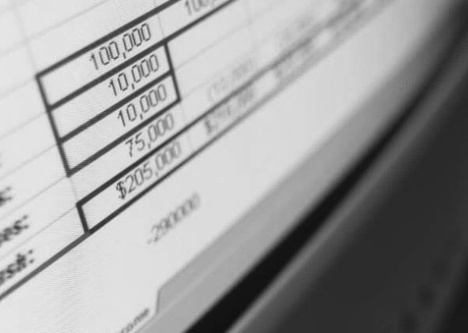
A Few Notes About Debt
It takes effort to obtain a small business loan.
Your credit score will directly influence your ability to secure a loan.
Talk with a bank’s commercial loan officer before you need the loan.
Other modules in this Money Smart series can help!

Slide 10
Opening Balance Sheet for The Wired Cup
Page 5 in your Participant Guide

Slide 11

Three Views of Cash Flow
Cash Conversion Cycle
Cash Flow Diagram
Cash Flow Statement

Slide 12
Cash Conversion Cycle
Business pays for raw materials or inputs
Money
IN
Money OUT
Business sells product or provides service
Business makes product or designs service delivery

Slide 13
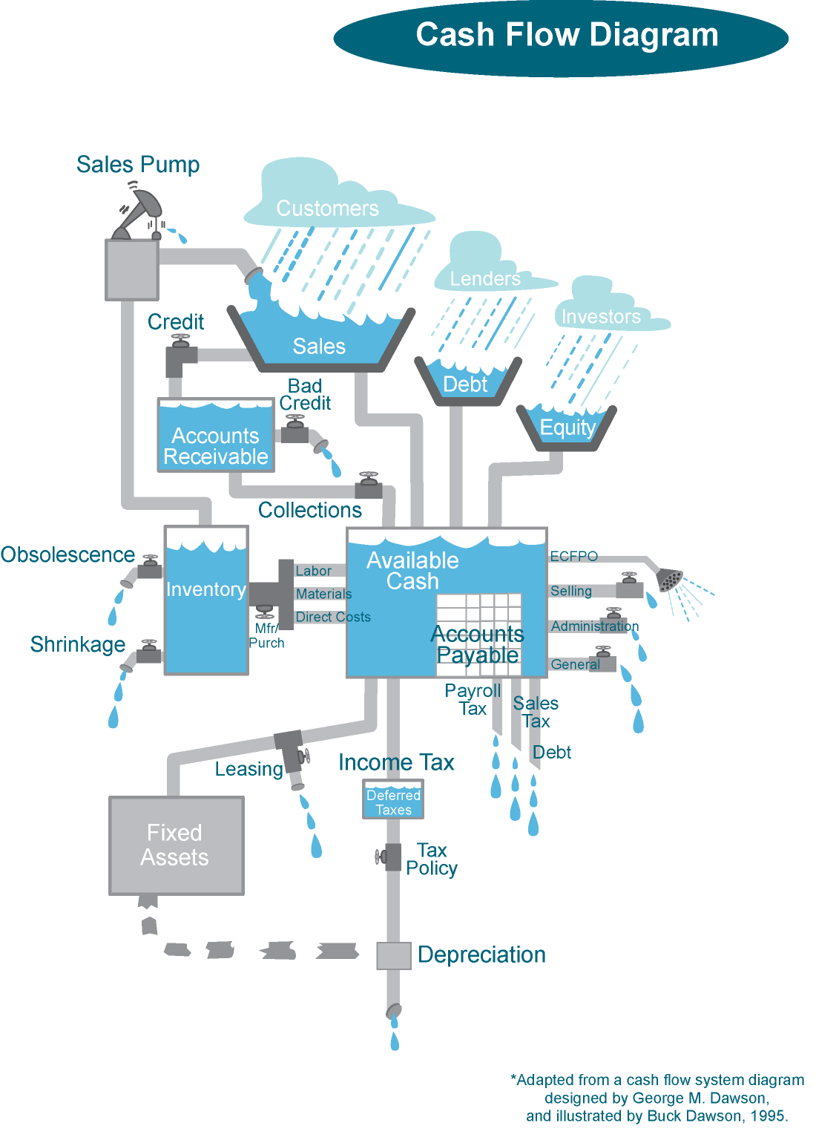
Cash Flow Diagram
Page 7 in your Participant Guide
This diagram has been adapted from a diagram designed by George M. Dawson and illustrated by Buck Dawson, 1995.

Slide 14

The Wired Cup Cash Flow Statement
Page 10 in your Participant Guide.
This statement tells a story:
How much money Bob has to run his business.
How much money is moving in and out of The Wired Cup.
Where the money is coming from and where it is going.
When that money is moving in and out of the business.

Slide 15
What Can Bob Do?
Group Discussion:
How can Bob increase sales revenue at The Wired Cup?
How could Bob negotiate a better deal with his vendors and suppliers?
How can Bob plan for seasonal ups and downs?
Is it wise for Bob to use a credit card to offset cash flow issues?
What do YOU recommend?

Slide 16
Possible Ideas for Bob
Increase revenue
Provide incentives for customers to pay in cash
Start catering
Sell gift cards
Increase number of corporate accounts
Negotiate with vendors and suppliers
Ask for better terms or payment plans
Landlord: pay entire year’s rent in 10 months not 12
Reduce costs during slow months
Staff
Store hours
Reduce menu options

Slide 17

What NOT to Do
Do not postpone paying estimated taxes
Do not hide from loan officers – they can provide invaluable advice
Do not pay vendors late (they can cut off supply)
Do not overestimate revenue
Do not underestimate costs

Slide 18

It Is Professional to Ask for Help
Ask for advice and feedback:
  Seek out expert technical assistance.
  An accountant can help find ways to increase income and reduce expenditures.
  Share ideas with other businesses to find ways to both compete and cooperate (co-opetition!)

Slide 19
Key Points to Remember
Managing cash flow is a core competency of small business ownership.
An opening balance sheet tells a compelling story.
A cash flow statement continues the story. Use it to monitor projected and actual income and expenses.
Plan for seasonal fluctuations.
Try to maintain a rapid cash conversion cycle.
Manage your paperwork like a pro.
Ask an accountant for advice.

Slide 20
Toolkit of Resources
See the Toolkit of Resources in your Participant Guide for more details.
Glossary of Cash Flow Terms
Cash Flow Statement Template
Negotiating Better Terms
For More Information: technical assistance options – many of these are free!

Slide 21
Pre-Post Test and Evaluation
In your Participant Guide
If you have not already done so, assess what your knowledge on this topic was before you participated in this class.
Assess your knowledge on this topic after taking this class.
Complete the Evaluation Form. Your feedback is helpful!
Return both forms to the instructor before you leave. Thank you!

